Slide 1


Convolutional neural networks
CARLOS PAVIA - CARLOS PORTA

Slide 2
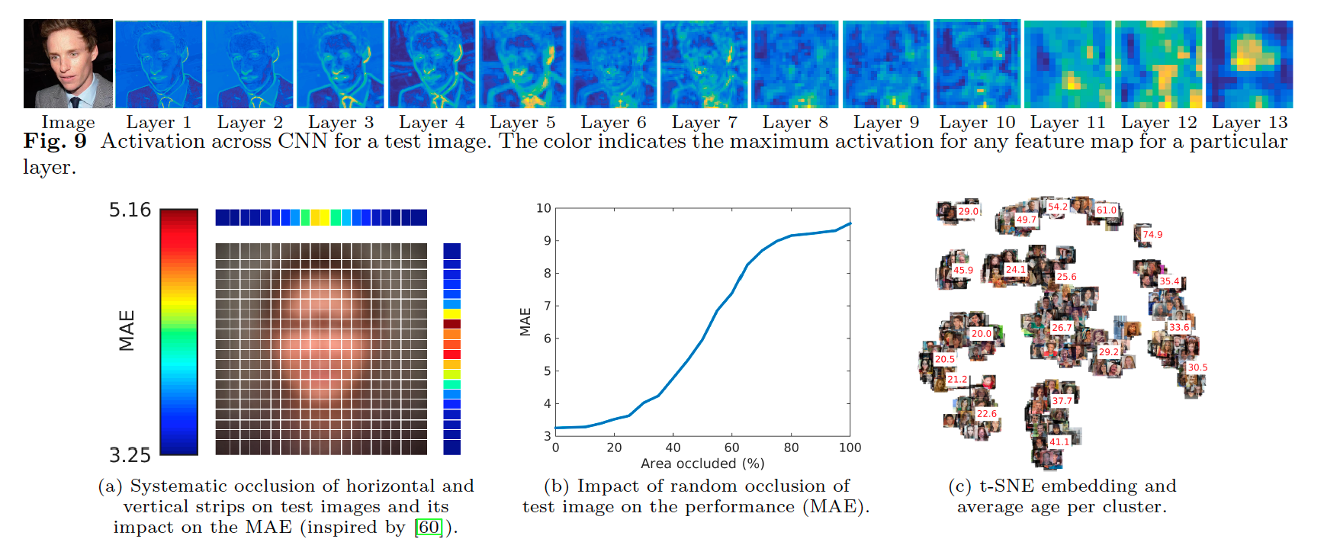
CNN - Deep layers for Image Processing

Slide 3
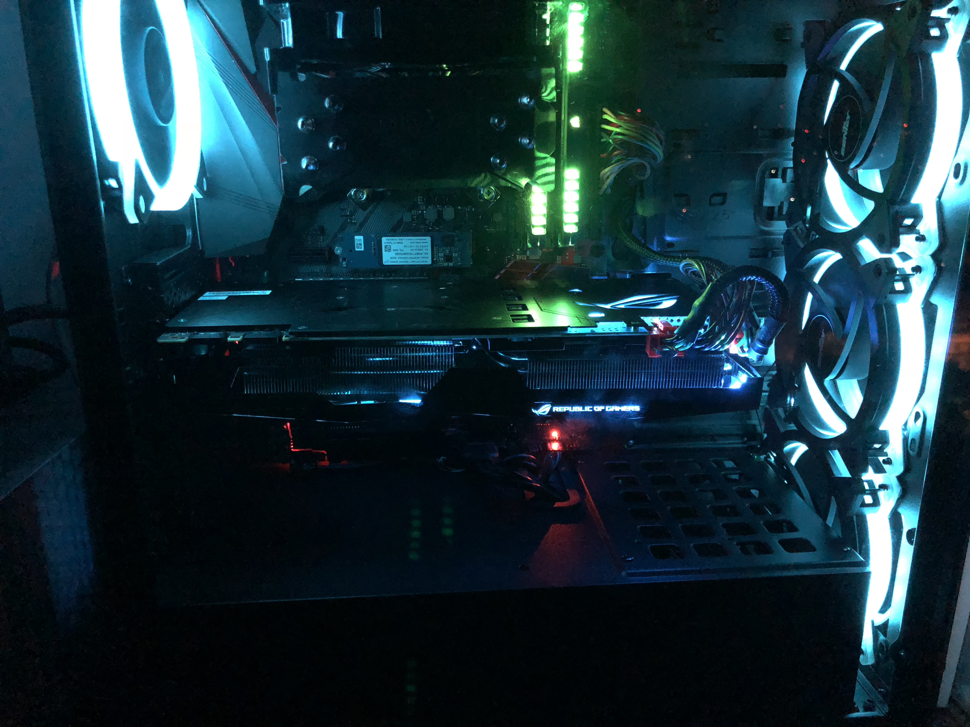
INTRO
1 -problema
2 -dataset
3 –wiresnet
4 – data Augmentation
5 – tainning wiresnet
6 – demo wiresnet
7 – feature extraction vgg16
8- feature extraction – inception v3
9- fine tunning vgg16
10 –feature extraction – mobilenet
11 – mayor calidad de los datos
12 - resultados

Slide 4
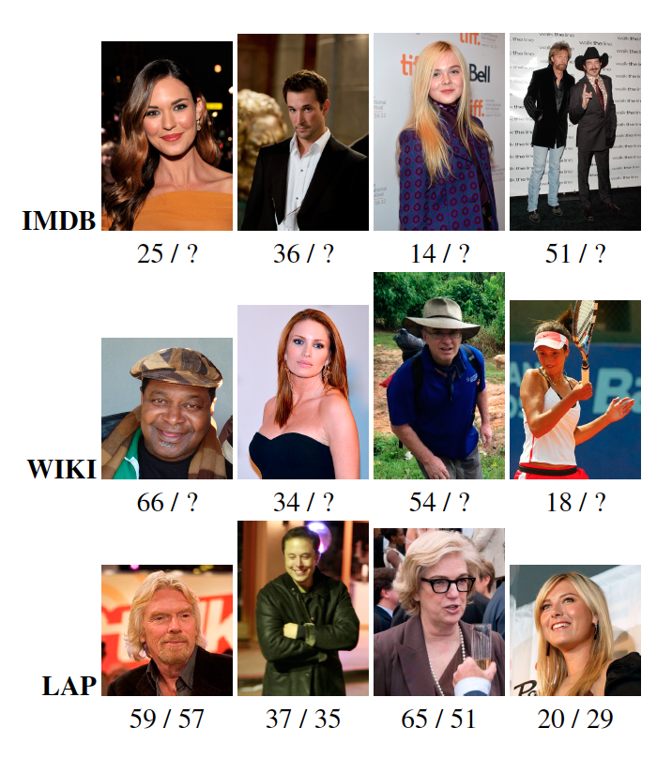
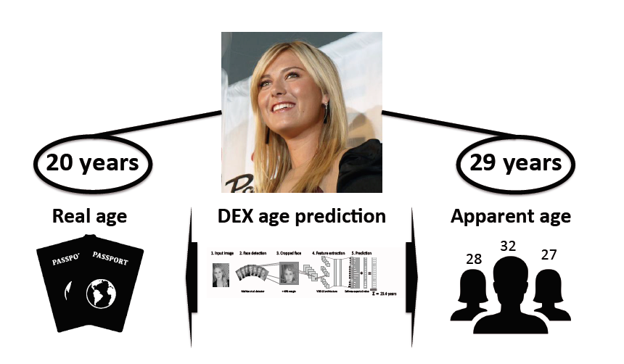

problema
Determinación de sexo y edad
Real vs aparente

Slide 5
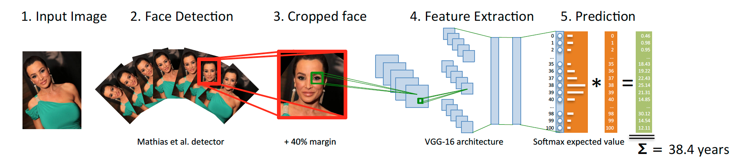
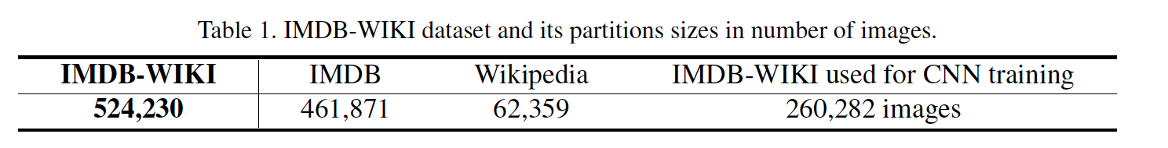
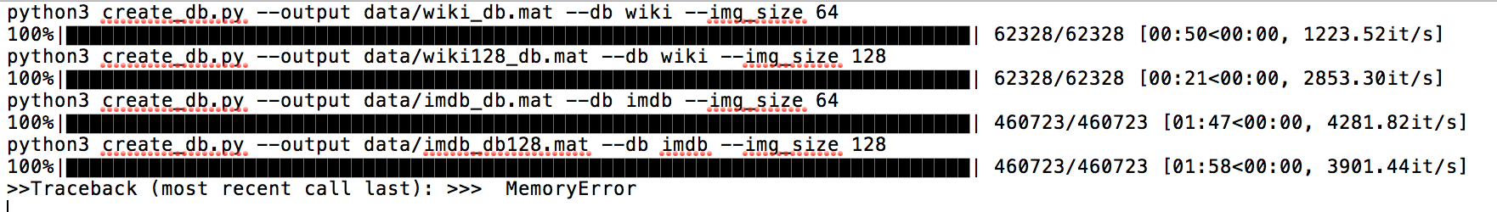
DEX: Deep EXpectation of apparent sex and age from a single image
DATASET

Slide 6
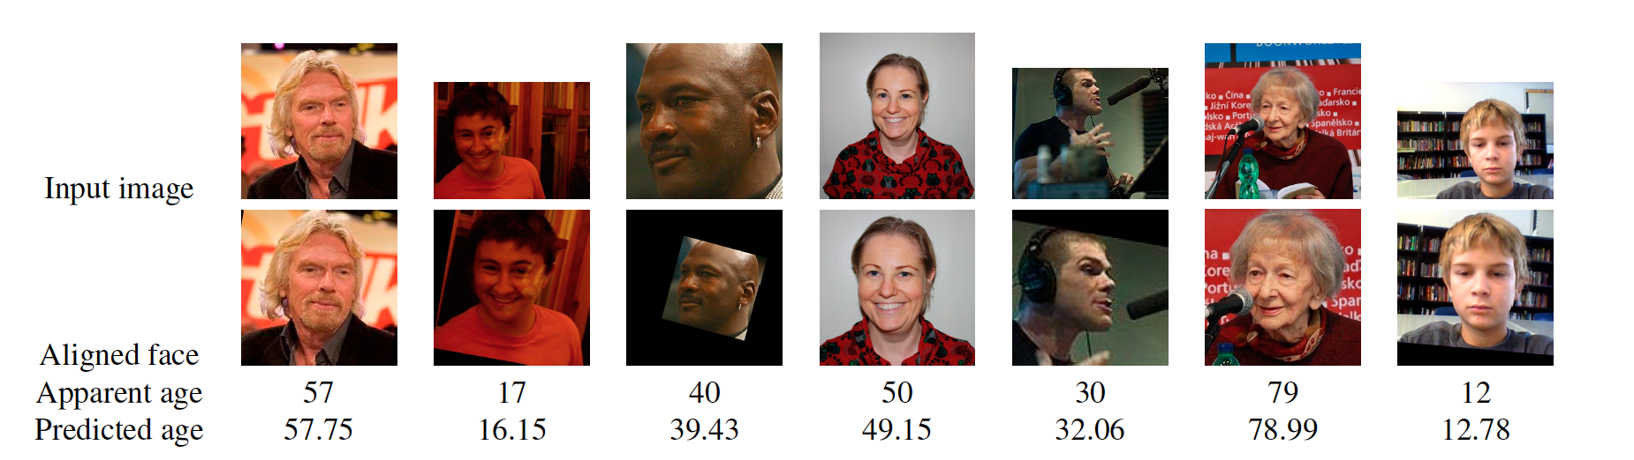
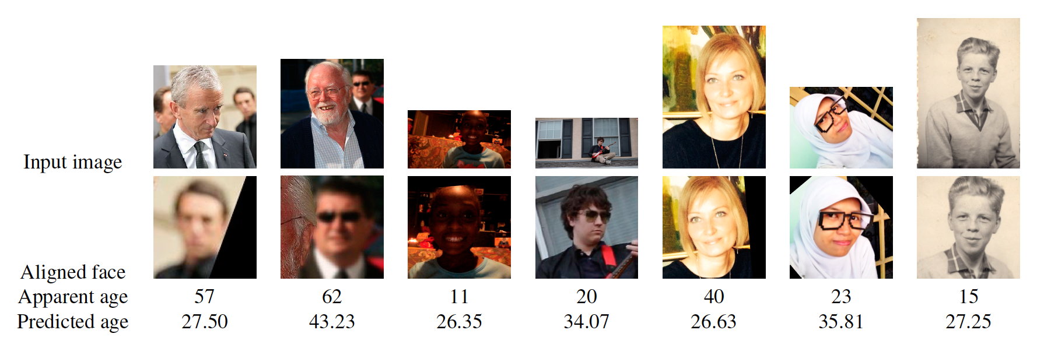
Works Ok
Fails

Slide 7
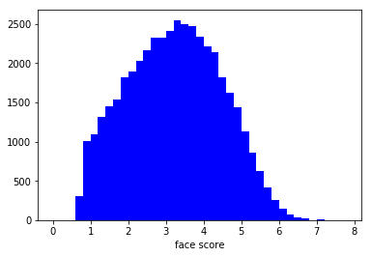
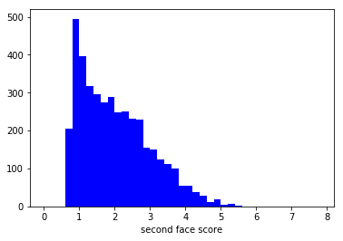
Face Score : Podando el Dataset….. O no…..

Slide 8
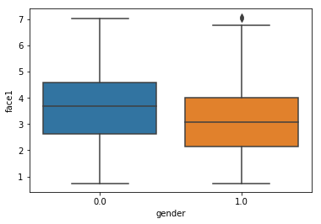
El primer filtrado fue eliminar las imágenes en las que no hay caras, en las que el género es indefinido (NaN), y aquellas en las que hay más
de 1 cara.
Este dataset fue el que usamos para los primeros experimentos, y aun variando arquitecturas, redes, técnicas, no se pudo superar el 85%.
Generamos un segundo dataset, filtrando imágenes de baja calidad, tomando las de mayor valor para el atributo face1 (que indica la presencia de una cara). Los mismos experimentos usando este nuevo dataset obtuviern accuracy entre 92% y 95%.

Slide 9
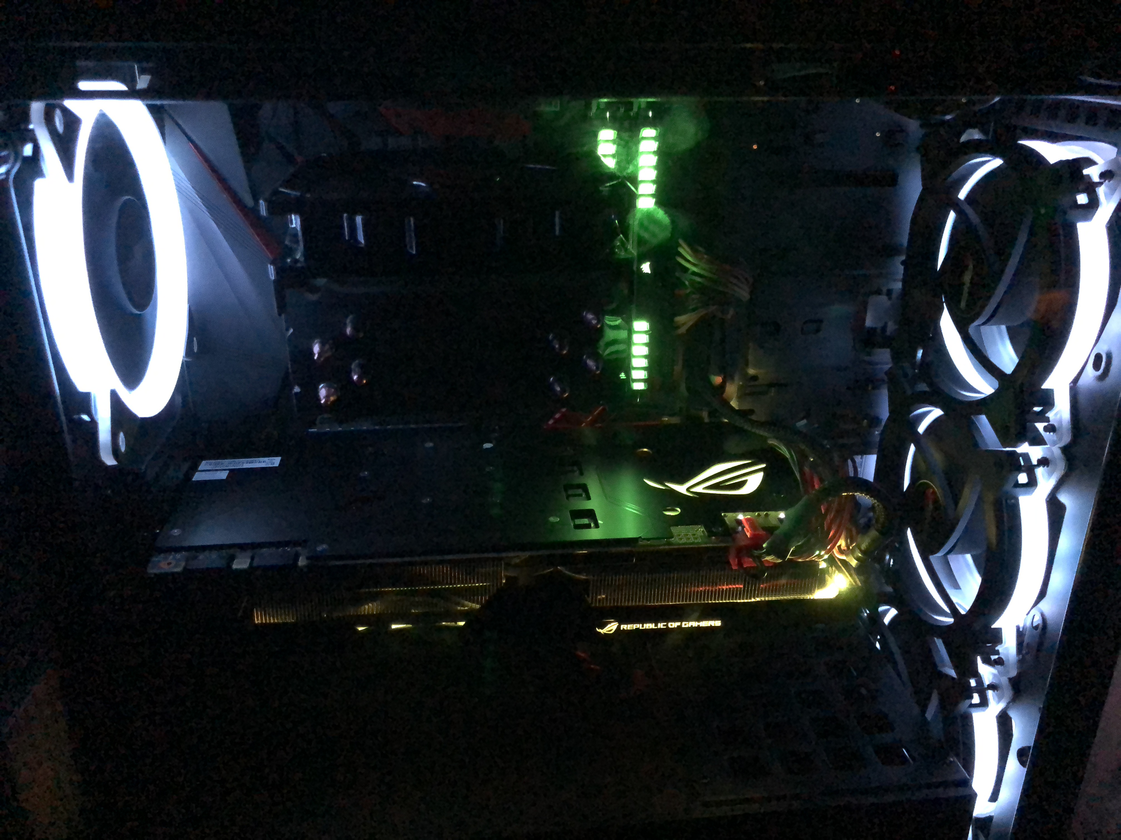
WIDERESNET

Slide 10
Deep residual networks were shown to be able to scale up to thousands of layers and still have improving performance. However, each fraction of a percent of improved accuracy costs nearly doubling the number of layers, and so training very deep residual networks has a problem of diminishing feature reuse, which makes these networks very slow to train. To tackle these problems, in this paper we conduct a detailed experimental study on the architecture of ResNet blocks, based on which we propose a novel architecture where we decrease depth and increase width of residual networks. We call the resulting network structures wide residual networks (WRNs) and show that these are far superior over their commonly used thin and very deep counterparts. For example, we demonstrate that even a simple 16-layer-deep wide residual network outperforms in accuracy and efficiency all previous deep residual networks, including thousand-layer-deep networks, achieving new state-of-the-art results on CIFAR, SVHN, COCO, and significant improvements on ImageNet
Wide Residual Networks
Deep residual networks were shown to be able to scale up to thousands of layers and still have improving performance.
However, each fraction of a percent of improved accuracy costs nearly doubling the number of layers, and so training very deep residual makes these networks very slow to train.
To tackle these problems, experimental study on the architecture of ResNet blocks, to decrease depth and increase width of residual networks.
Even a simple 16-layer-deep wide residual network outperforms in accuracy and efficiency all previous deep residual networks, including thousand-layer-deep networks, achieving new state-of-the-art results on CIFAR, SVHN, COCO, and significant improvements on ImageNet

Slide 11
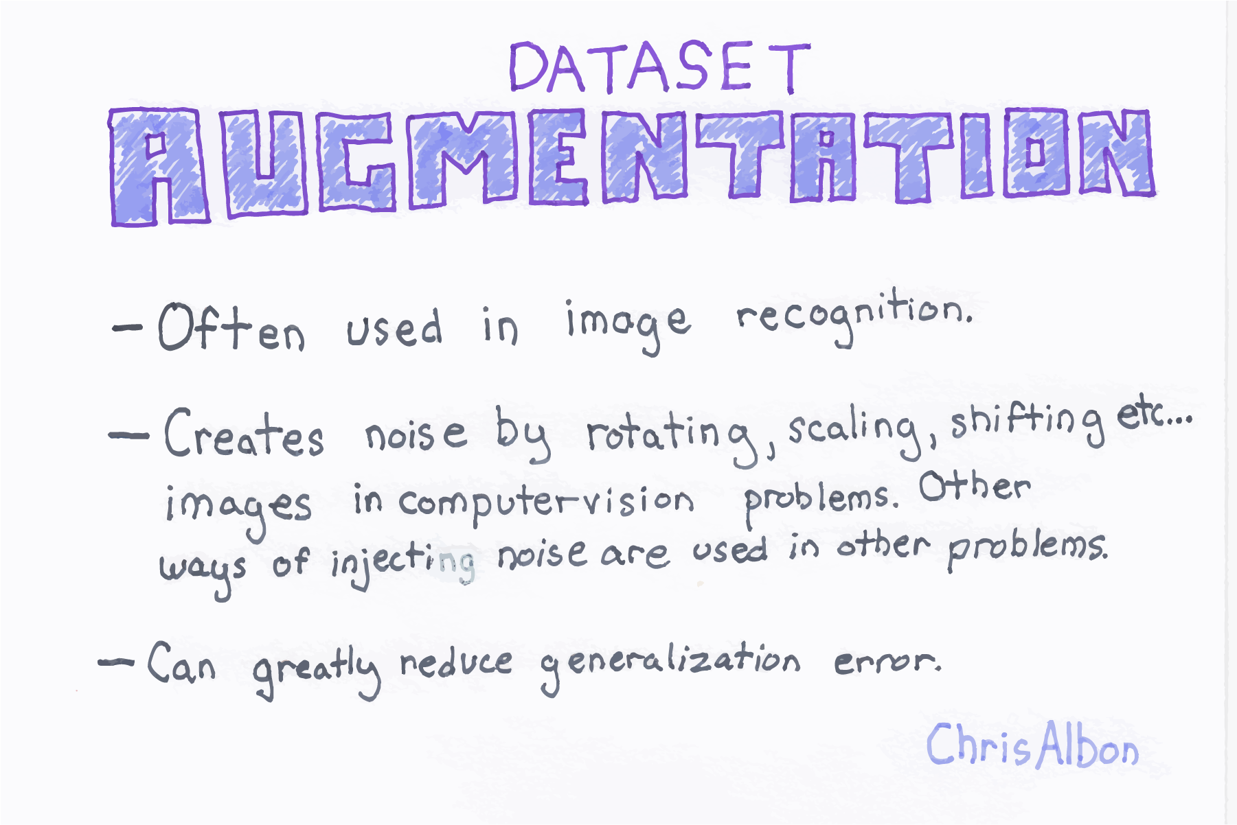

Slide 12
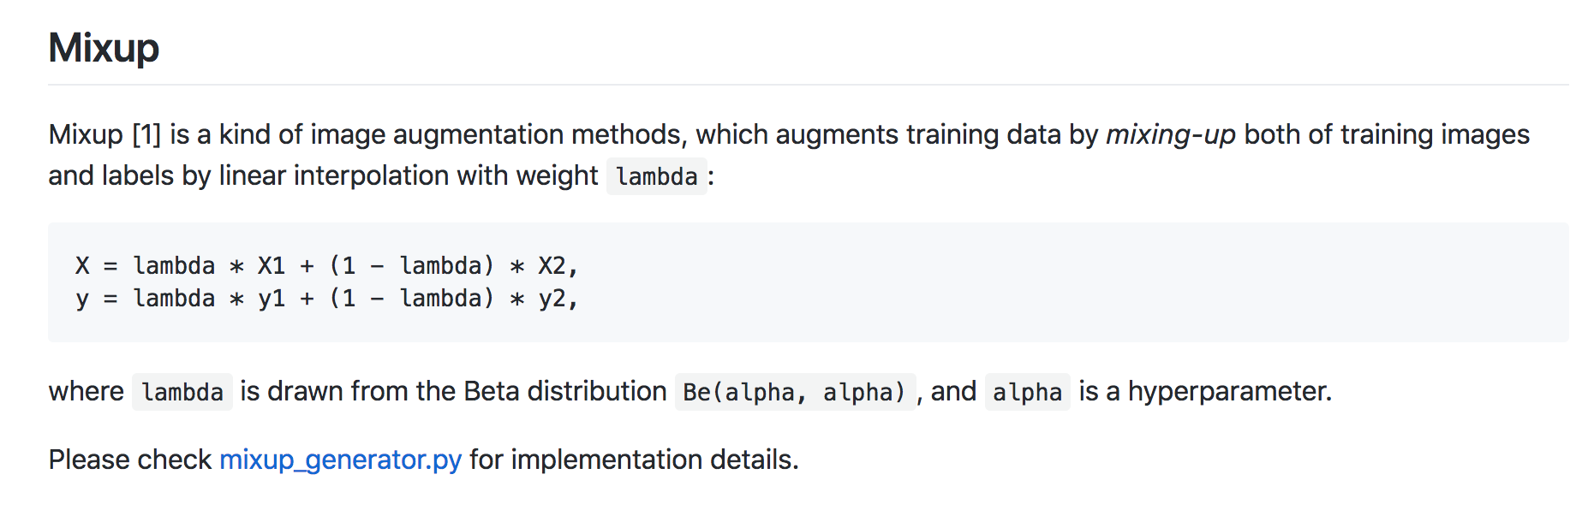
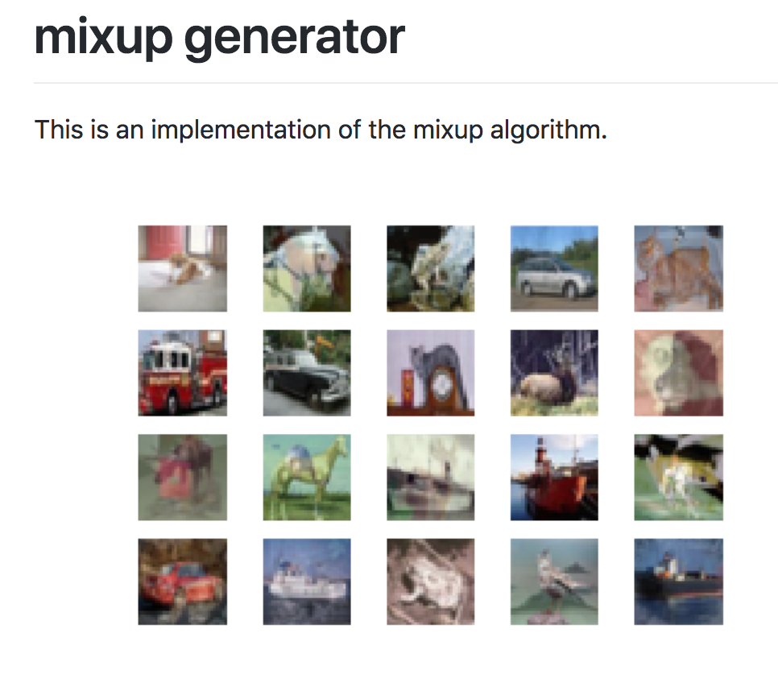

Slide 13
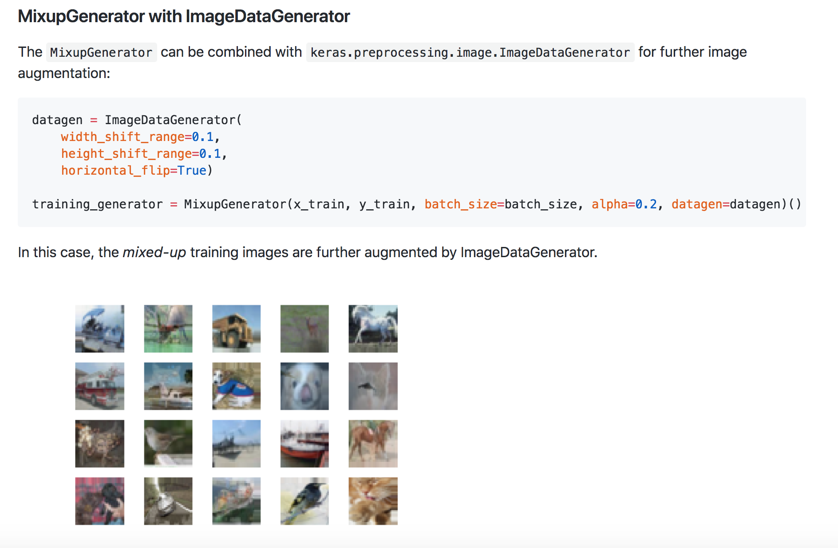

Slide 14
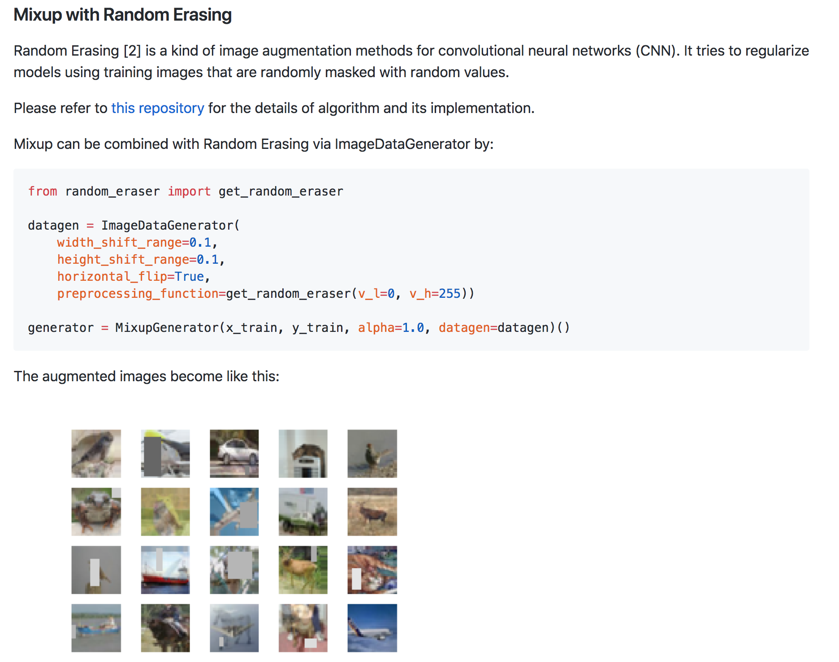

Slide 15
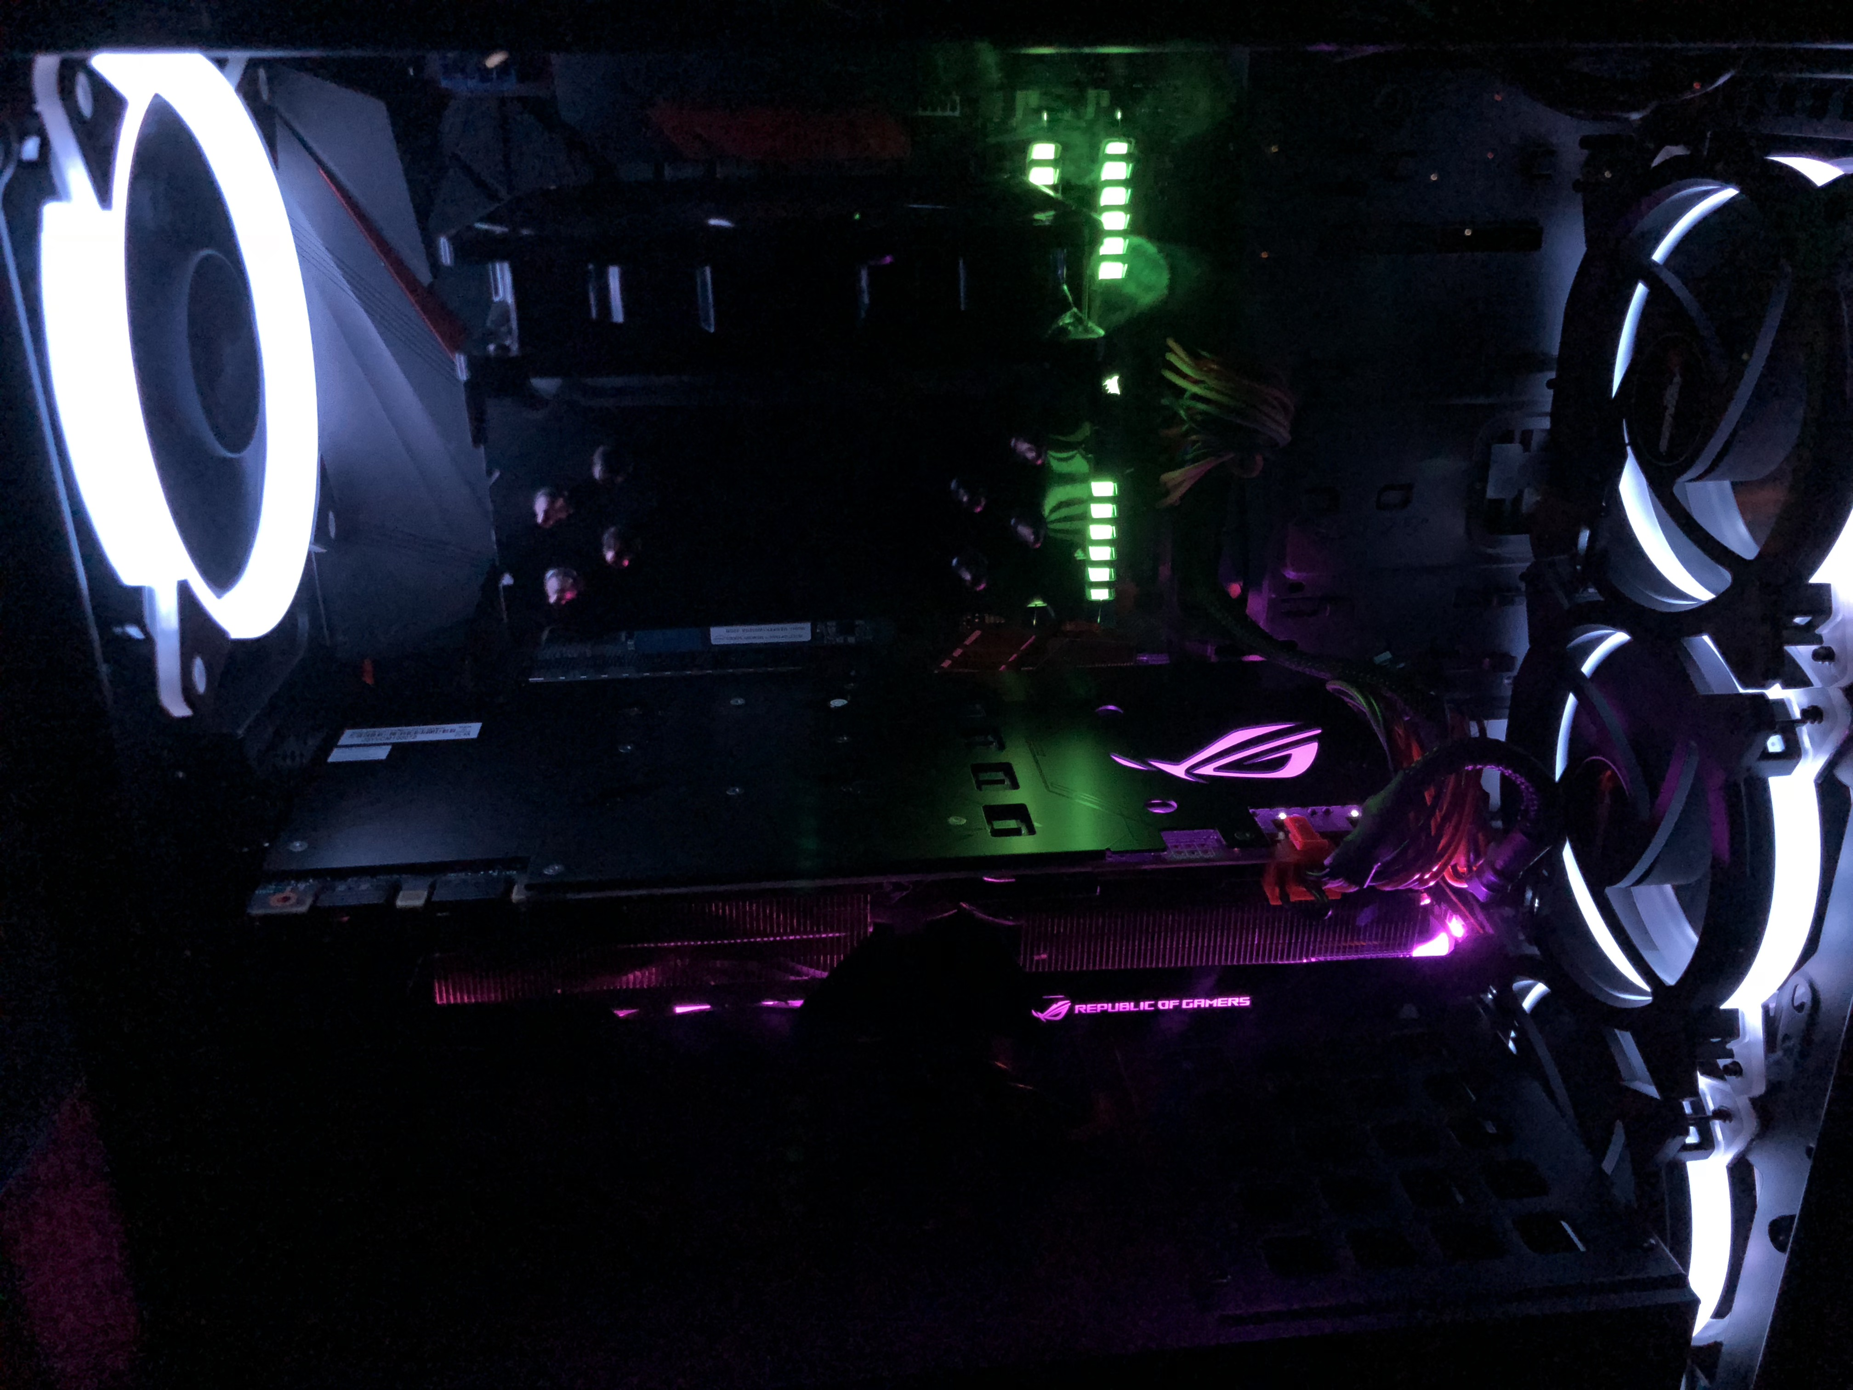
TRAINNING

Slide 16
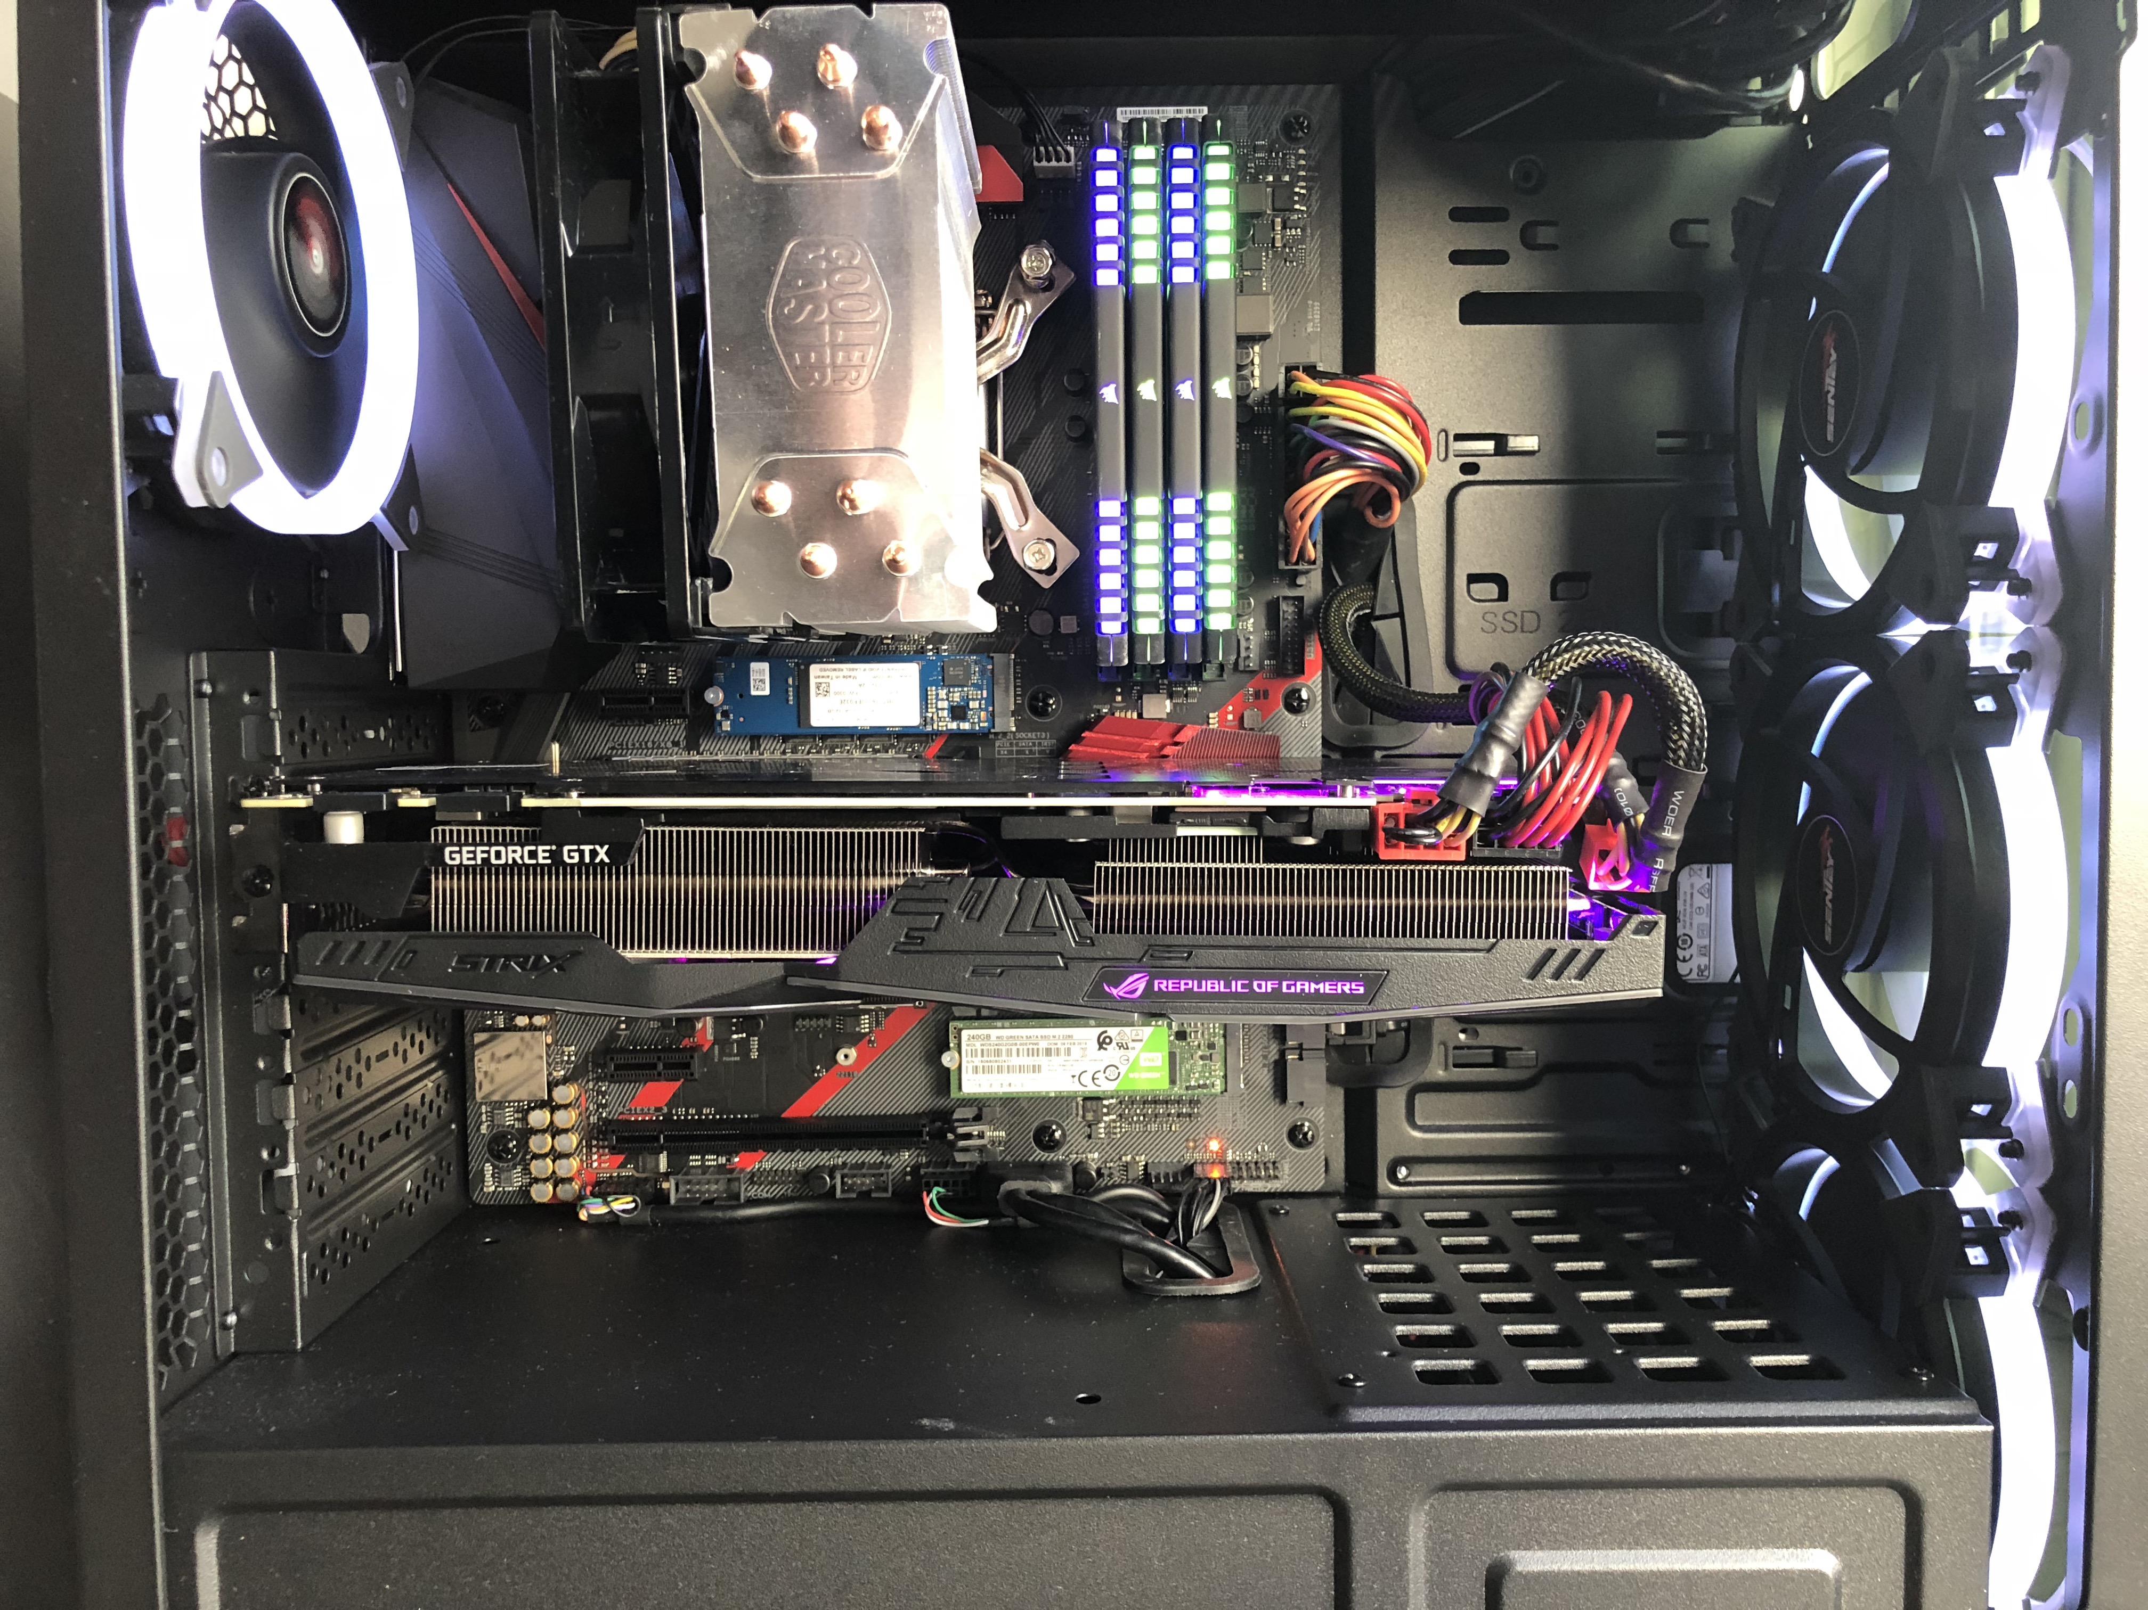
i7 8700k - z370h - M2 ssd - Intel Optane –32gb ddr4 3200
GPU:Asus Rog strix gtx 1080 TI OC Edition 11gb DDR5
(GeForce GTX 1080 Ti, compute capability: 6.1)

Slide 17






18.4 LTS
Nvidia-SMI 390
Cuda Toolkit 9.0
cuDNN 7.0.5
libcupti-dev
Keras 2.2.0
Anaconda 5.2
r1.9

Slide 18
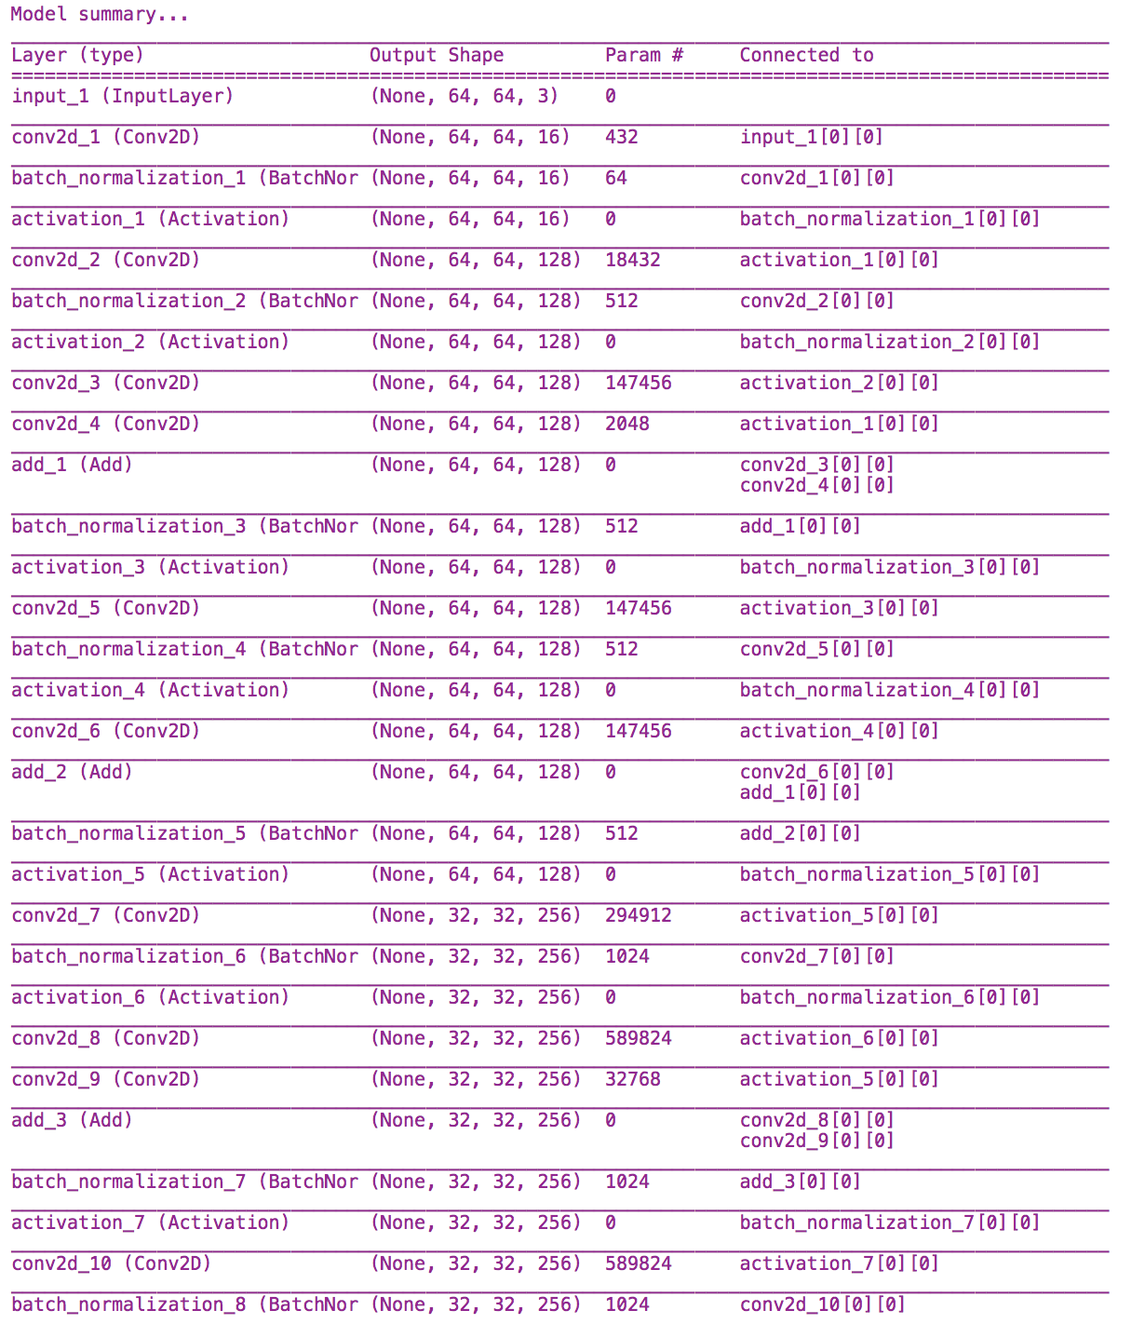

64x64
WRN-16-8

Slide 19
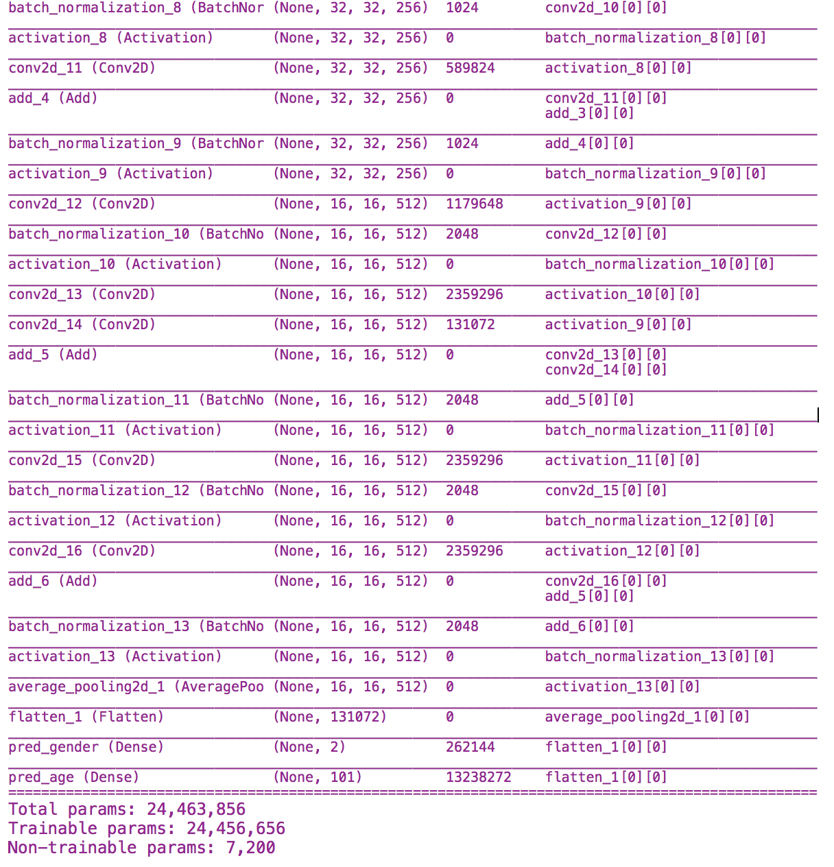

64x64
WRN-16-8

Slide 20
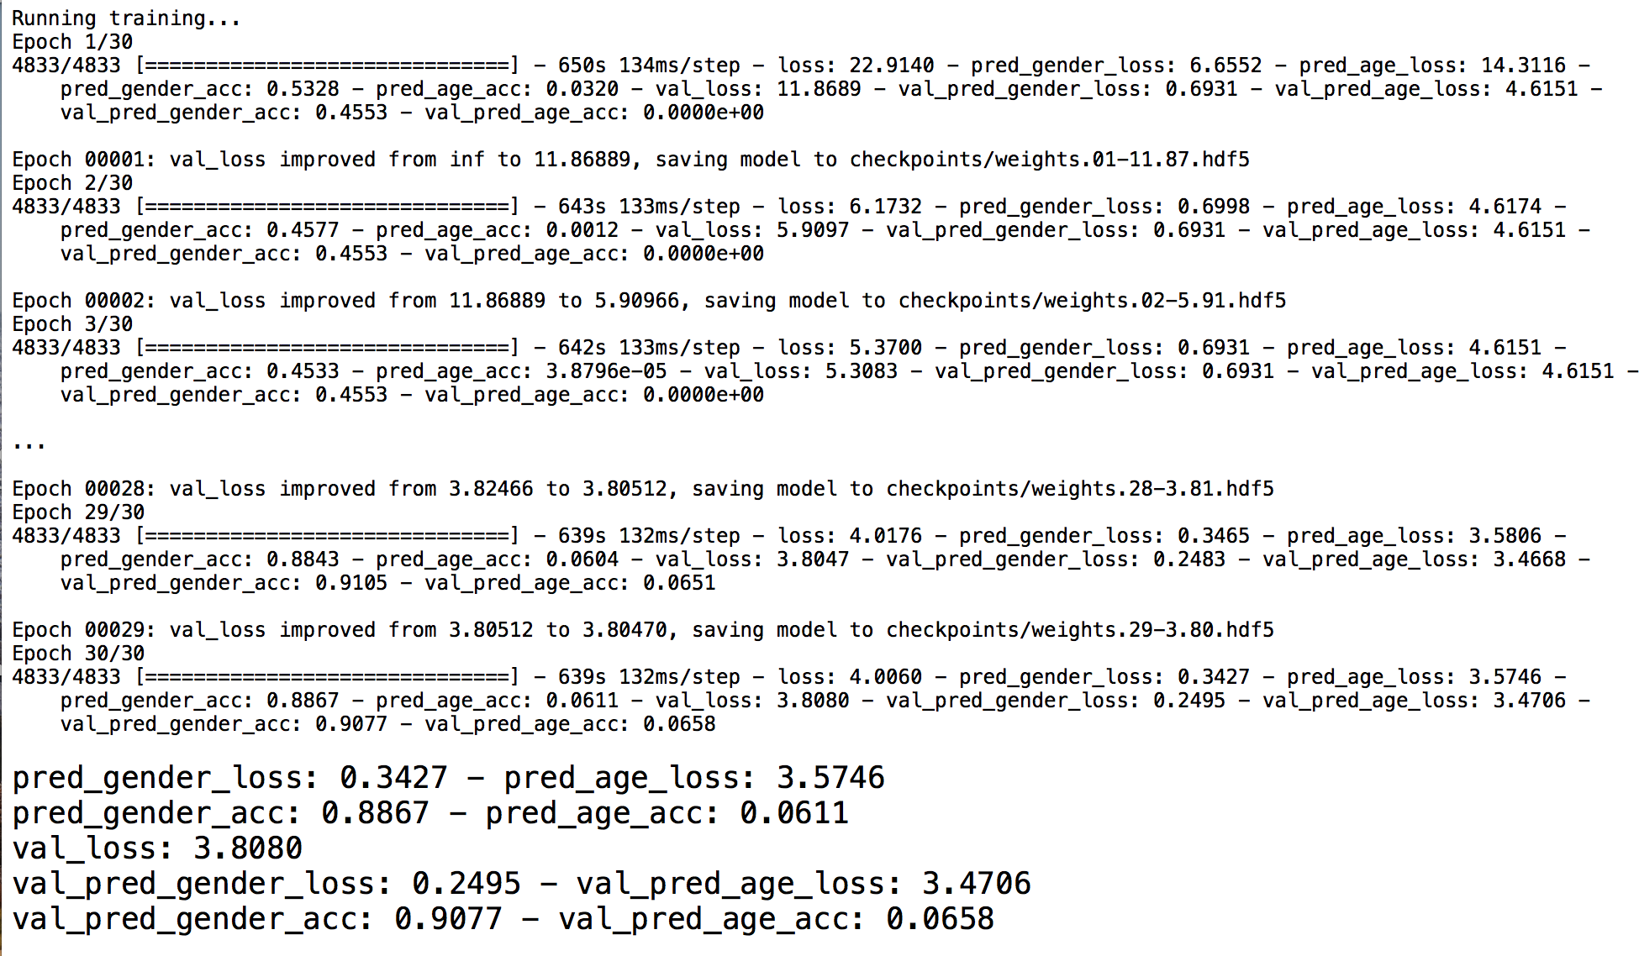

Slide 21
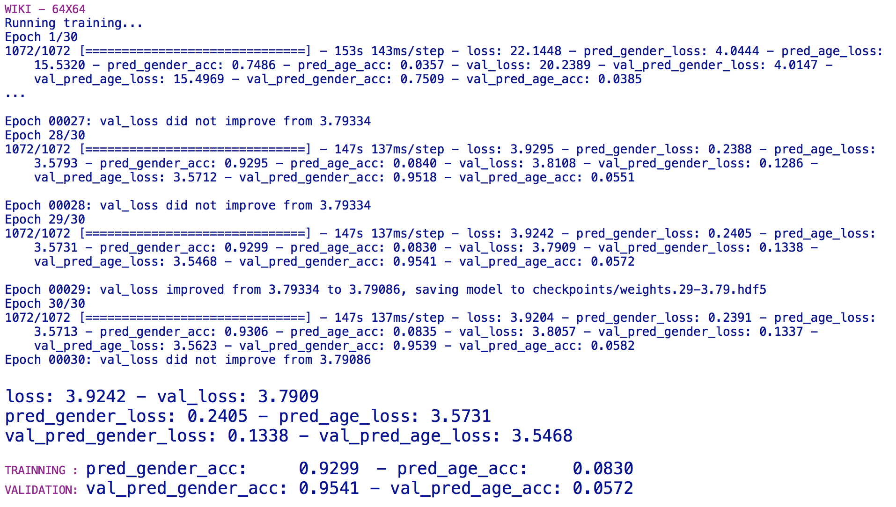

Slide 23
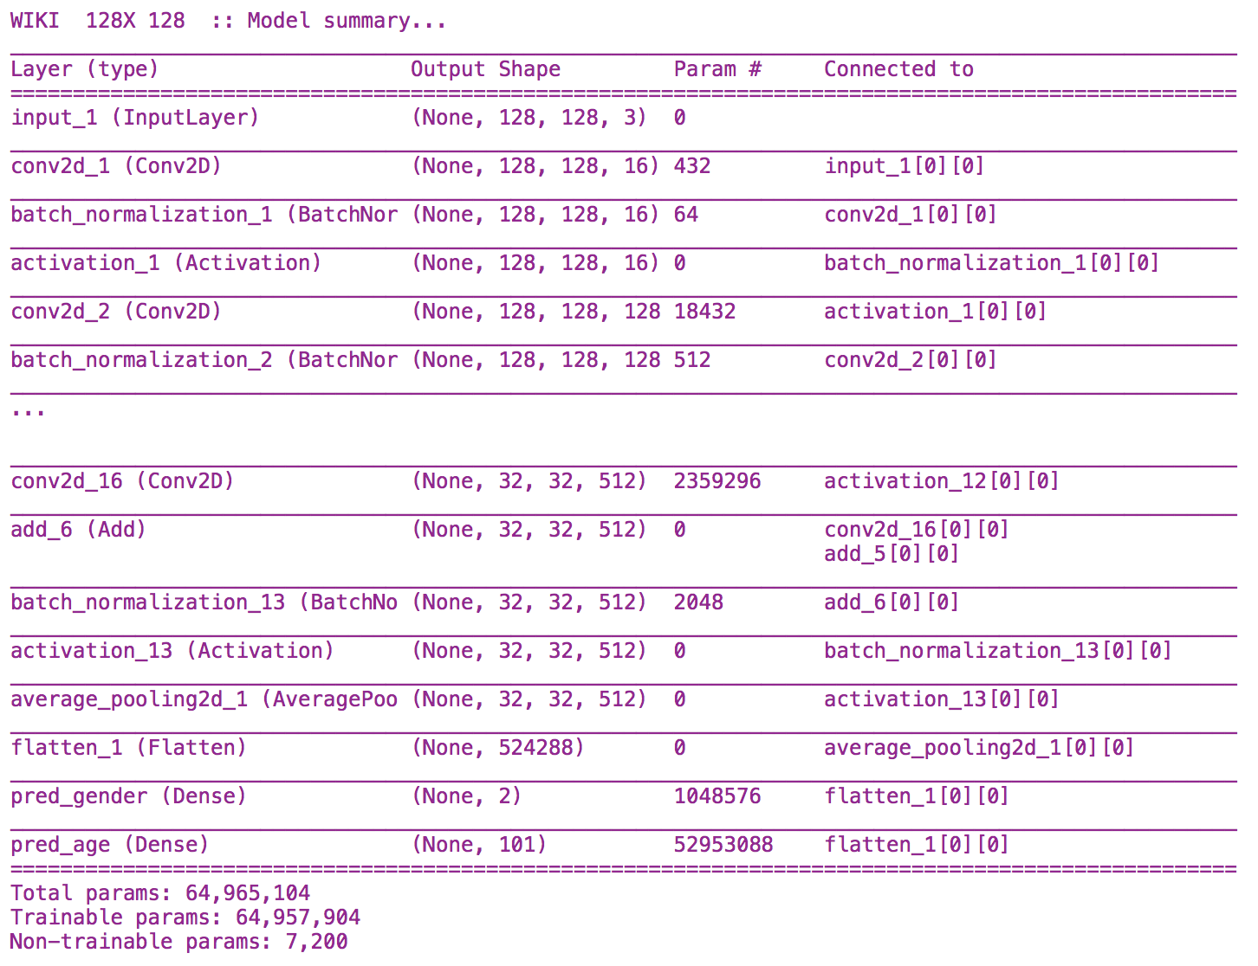


Slide 24
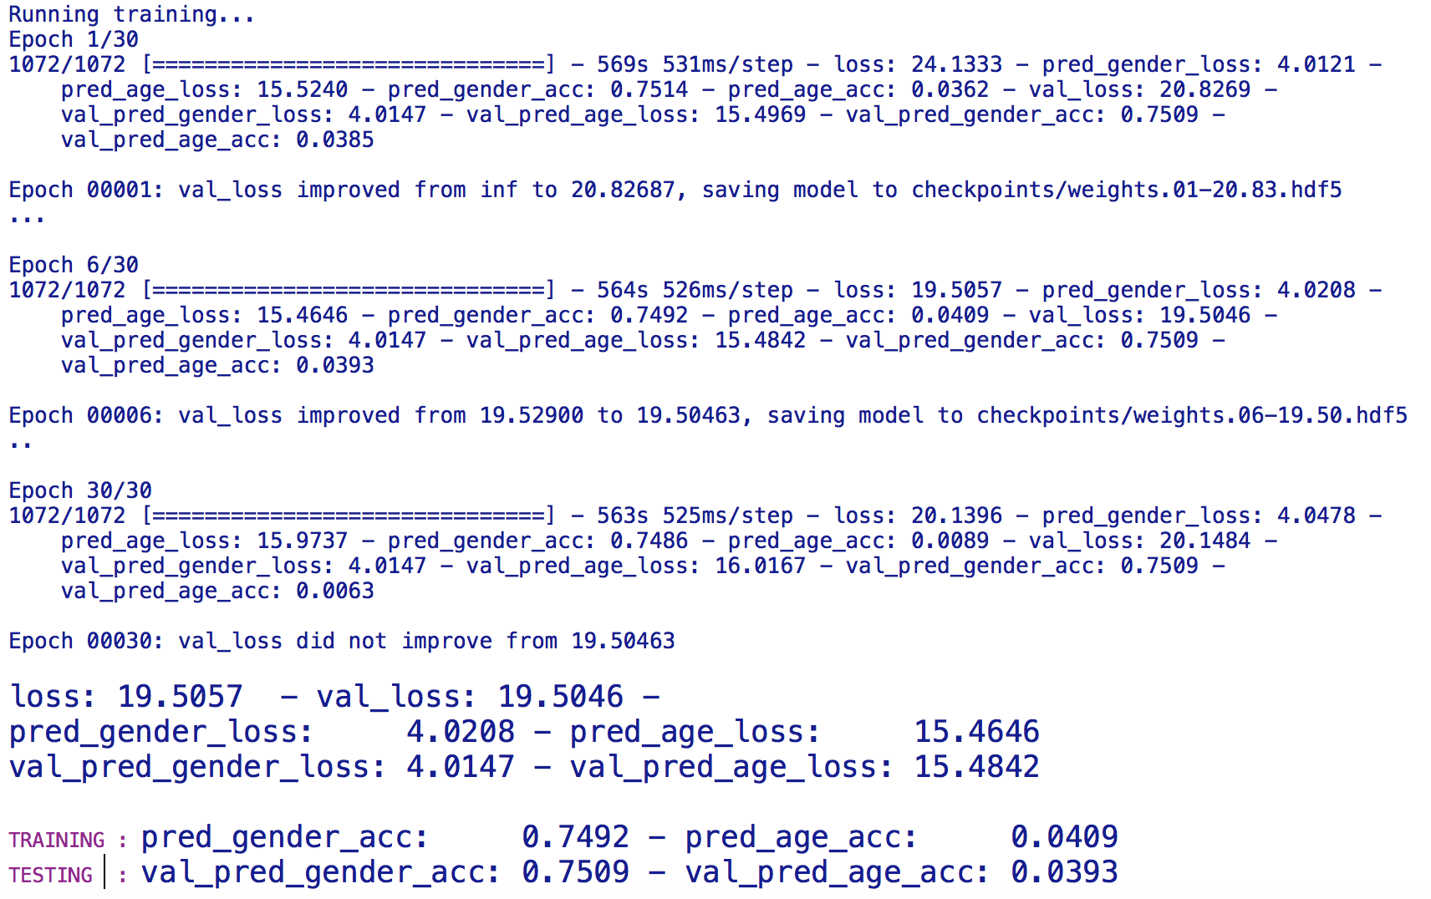

Slide 25
DEMO wiresnet

Slide 26
Jupyter come back
feature extraction - vgg16
feature extraction – inception v3
fine tunning - vgg16
feature extraction – mobilenet
mayor calidad de los datos

Slide 27
Conclusiones Y RECOMENDACIONES
EXPERIMENTAR
EXPERIMENTAR
EXPERIMENTAR

Slide 28
THE END

